Slide 1
Natural Logarithm and Antilogarithm

Slide 2
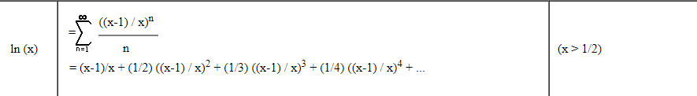
Taylor Series Logic for finding Logarithm
Logarithm of a number can be found out by solving the taylor series
C:\Users\Deepu kr\Desktop\LOgarith\Taylor Final\logseries.vi

Slide 3
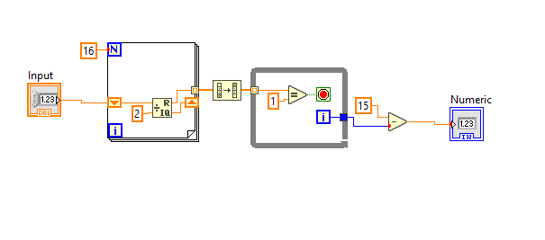
Using Priority Encoder Logic
Basically output of priority encoder is nothing but the characteristic part of log to the base 2 of the input .

Slide 4
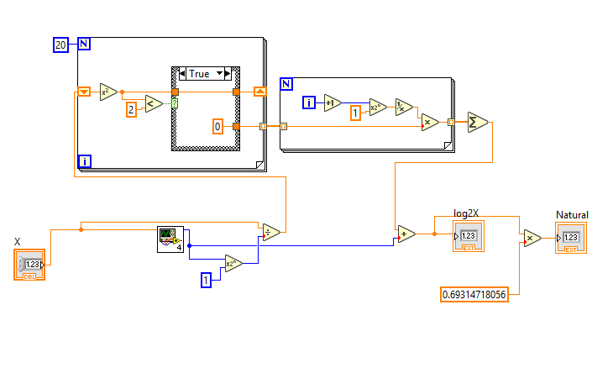

Slide 5
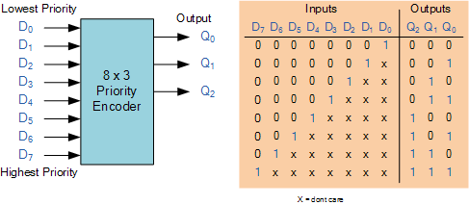

Slide 6
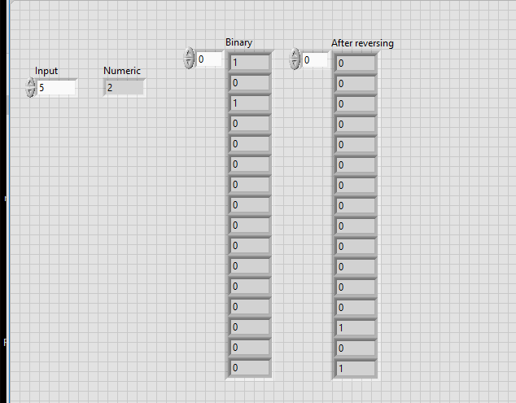

Slide 7
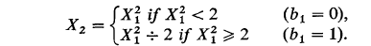
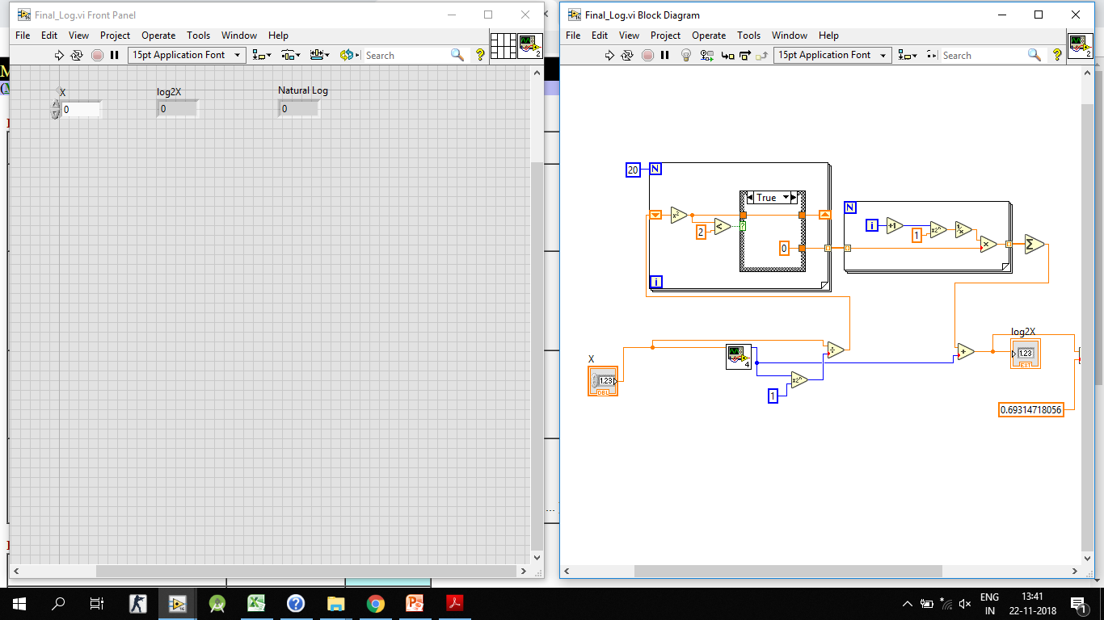
To find the Mantissa part , the below method can be used
The above equation can computed any number of times , more the number of iteration , more will be the accuracy
After Storing the bits in Array , they have to converted into decimal
Fractional binary to Decimal algorithm is implemented in this Stage

Slide 8
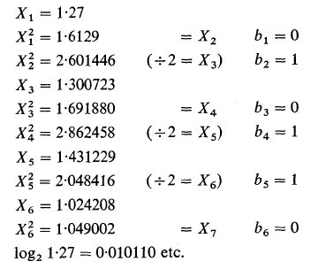

Slide 10
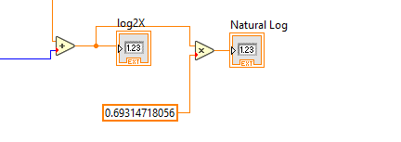
Then the Characteristic and mantissa part can be added to get the answer ( i . e log to the base 2)
According to the property of log, To Convert Log to the base 2 to Natural , answer should be multiplied by 0.693 (i.e Natural log of 2 ),

Slide 11
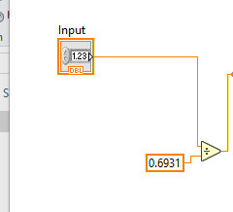
To find Antilog
Since log to the base 2 can be found using encoder , Decoder logic can be used to find the antilog of base 2 numbers.
For finding it, first number should be divided by natural log of 2 i.e.6931

Slide 12
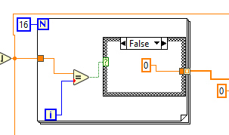
Decoder part
Decoder part will find the antilog of only characteristic part of the input, So the input for the decoder should be Nearest integer (Round to – infinity is used for this ).
The below given part is Decoder logic(I.e It will make output bit HIGH corresponding to the input , i.e if the input is 2 , it will make 3rd bit or 2 position HIGH.

Slide 13
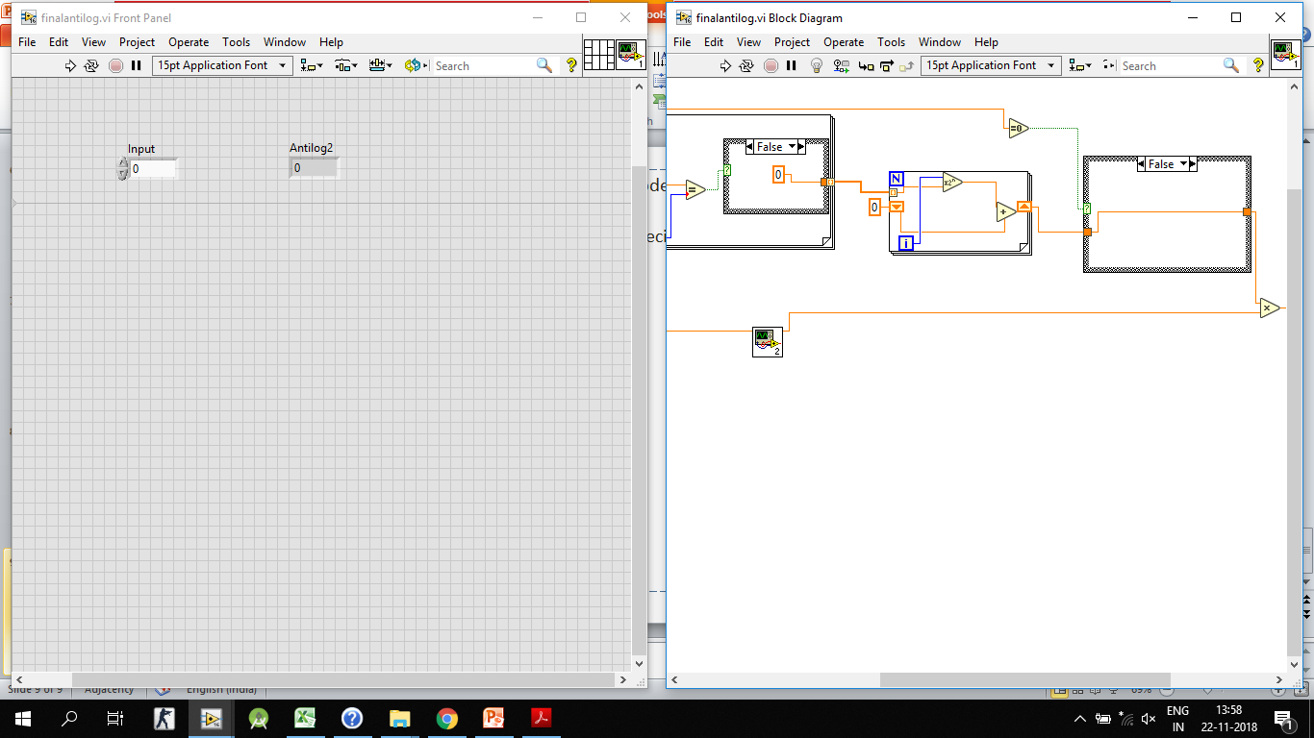
Results of the decoder part is saved in an array in the form of binary .
In the next stage Decimal conversion will happen .

Slide 14
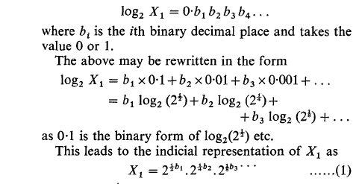
To calculate the antilog of base 2 part of mantissa of the input,the below algorithm can be used
Then the decoder part and this is multiplied to get final output

